Slide 2
The Ownership and Management of Small Multifamily Rental Properties
New Insights on an Overlooked Part of the Rental Market
Shazia Manji, Research Associate
Nathaniel Decker, Terner Affiliate
ternercenter.berkeley.edu

Slide 3
Why small multifamily rentals (5-49 unit)?
17%
of U.S. rental stock
Understudied in academic research
Unique property management and financing challenges
Underrepresented by landlord associations
Small multifamily rentals make up 8.2 million units across 493 thousand properties.¹
TERNER CENTER FOR HOUSING INNOVATION UC BERKELEY
1. Rental Housing Finance Survey, 2021

Slide 4
Methodology
Format: Nationwide, online survey of owners and managers of 5-49 unit rental properties
Timing: July - September, 2022
Analysis of 764 responses
Weighted by property size to match national distribution of 5-49 unit properties (2021 RHFS)
Survey Topics
Owner characteristics
Property finances
Property management practices

Slide 5
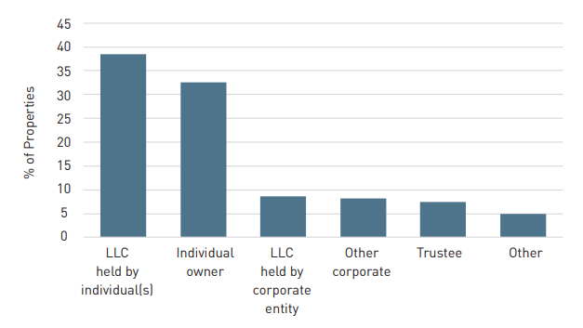
Most properties were owned by individuals, although they often established an LLC to hold the property
TERNER CENTER FOR HOUSING INNOVATION UC BERKELEY

Slide 6
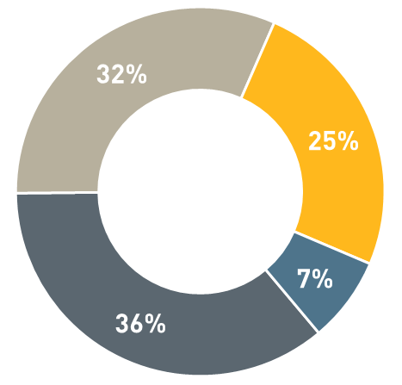
Owner Characteristics
Share of Properties by Owner Employment
Top Reasons for Acquisition
Rental income (71%)
and capital gains (30%)
Retirement (42%) and
family security (26%)
Provide affordable housing
in community (16%)
Retired
Corporate entity or full time investor
Employed full or part time
Other
TERNER CENTER FOR HOUSING INNOVATION UC BERKELEY

Slide 7
Tenant Screening and Selection
Owners reported that credit checks were the most important screening method
Personal interviews were more important among owners with small portfolios
Online screening tools were more important among owners with
large portfolios
TERNER CENTER FOR HOUSING INNOVATION UC BERKELEY

Slide 8
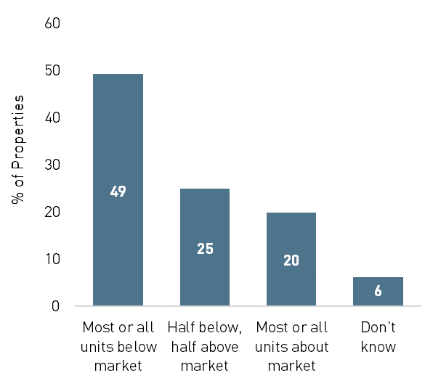
Below market rents are common in SMF
Owner Reported Rent Levels
Why are rents below market?
Prevent turnover
32%: rents rarely change at renewal
Ensure tenant can pay consistently
“Other”: rent restrictions, property condition and age, and/or subsidy
program regulations
TERNER CENTER FOR HOUSING INNOVATION UC BERKELEY

Slide 9
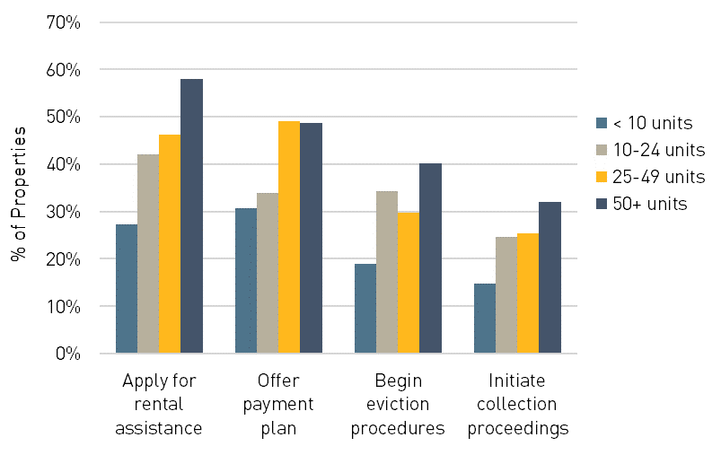
Late rent payments increased during the pandemic; bigger landlords more likely to take action
Responses to Rent Delinquency by Portfolio Size
Moderate to severe cash flow problems in 28% of properties
Owner pursued rental assistance (45%)
Owner began eviction proceedings (33%)
TERNER CENTER FOR HOUSING INNOVATION UC BERKELEY

Slide 10
Finances and Financial Performance
Many small multifamily properties show signs of substantial financial problems
1 in 5 properties have been turned down for financing
Owners of about 25% of properties reported no profit
Moderate to severe cash flow problems in 28% of properties
TERNER CENTER FOR HOUSING INNOVATION UC BERKELEY

Slide 11
Maintenance Practices
Most properties were in excellent or good condition according to their owners; however, 28% need substantial improvements
Owners of 25% of properties report postponing maintenance
Serious cash flow problems were associated with deferred maintenance
Higher rents and newer stock associated with better property condition
TERNER CENTER FOR HOUSING INNOVATION UC BERKELEY

Slide 12
Reflections
Small multifamily owners are mixed in terms of professionalism
Important source of unsubsidized lower-cost housing
Habitability and affordability are of concern, esp. older stock and those held by small-scale owners
Important target for preservation
Opportunities for
Further Research
Tenant perspective
Reporting requirements
Geographic variation
TERNER CENTER FOR HOUSING INNOVATION UC BERKELEY

