Slide 1
Terner webinar
August 15, 2023

Slide 2
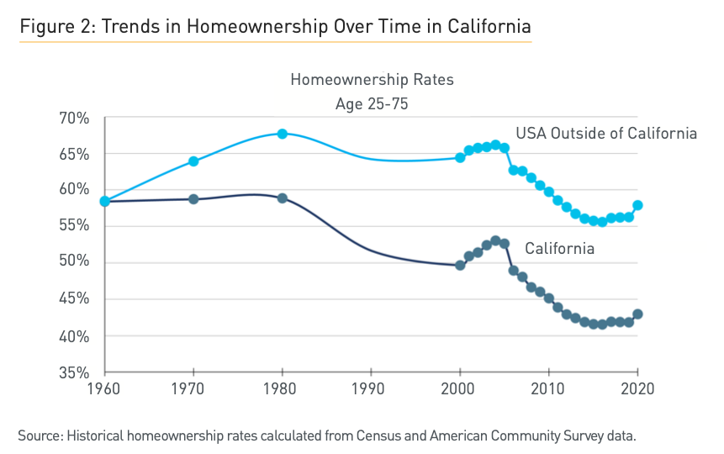
Big picture
Homeownership in California has been eroding for many decades. How much does this owe to delayed lifecycle milestones, versus housing unaffordability?

Slide 3
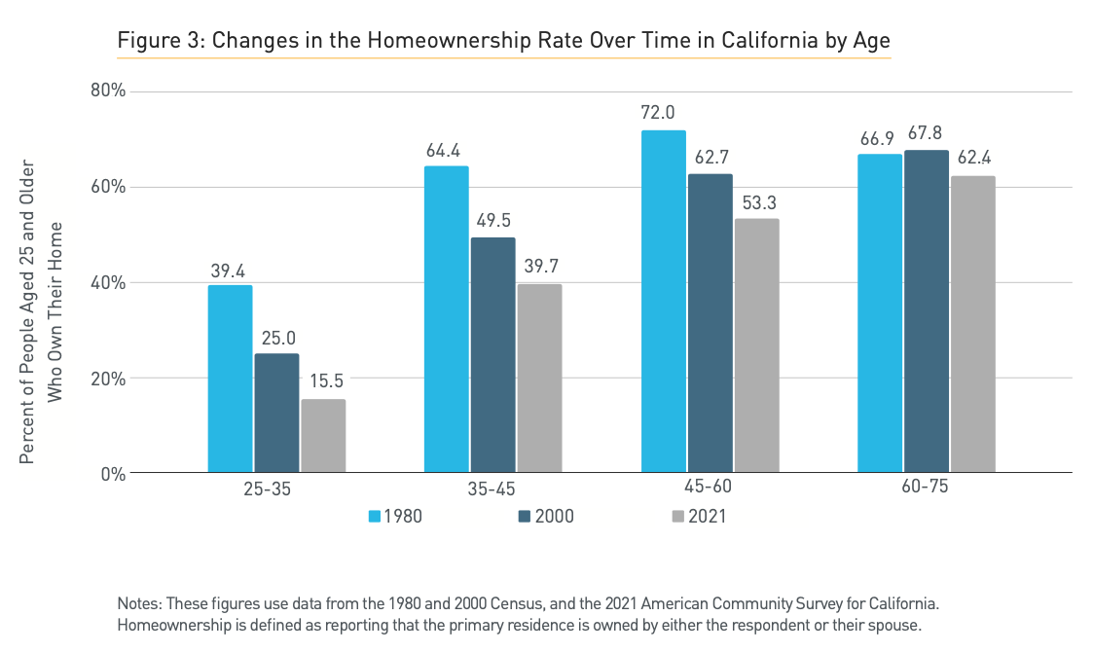
Homeownership by age

Slide 4
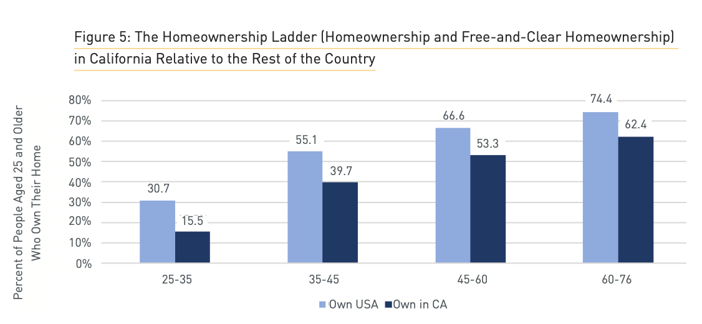
Homeownership in California vs the U.S.

Slide 5
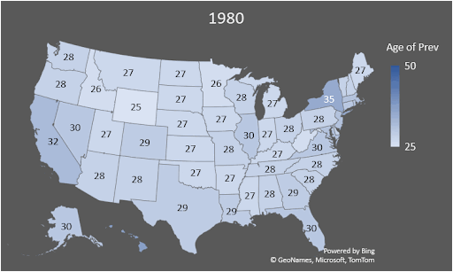
The homeownership prevalence age

Slide 6
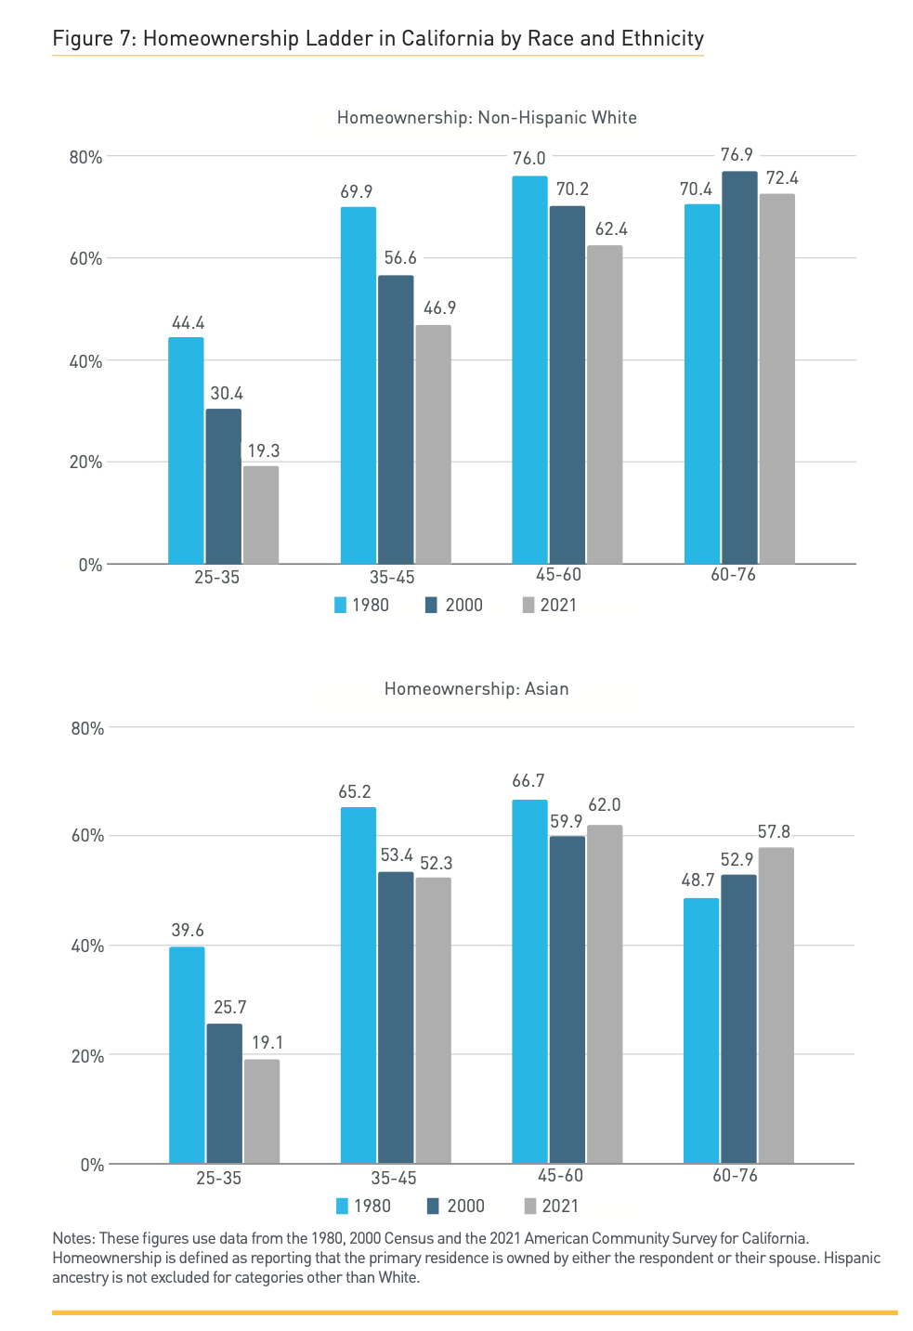
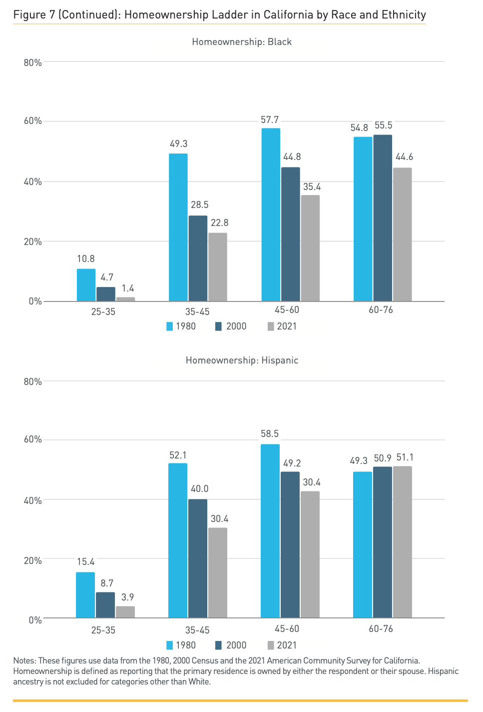
Breakouts by race/ethnicity

Slide 7
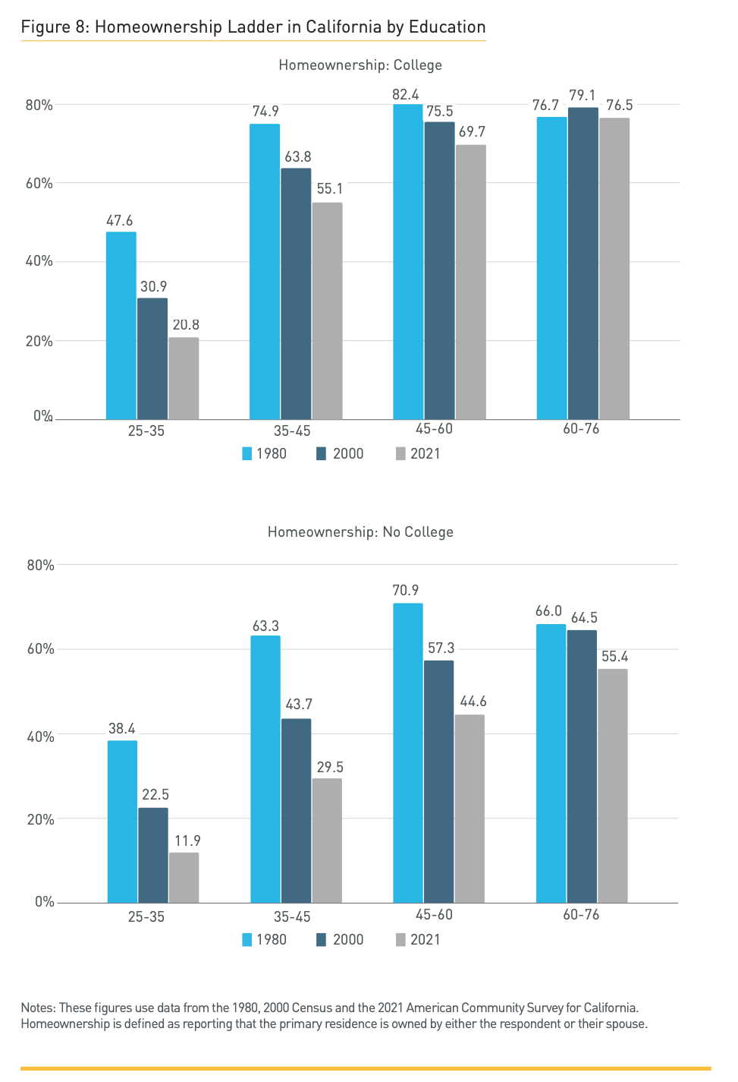
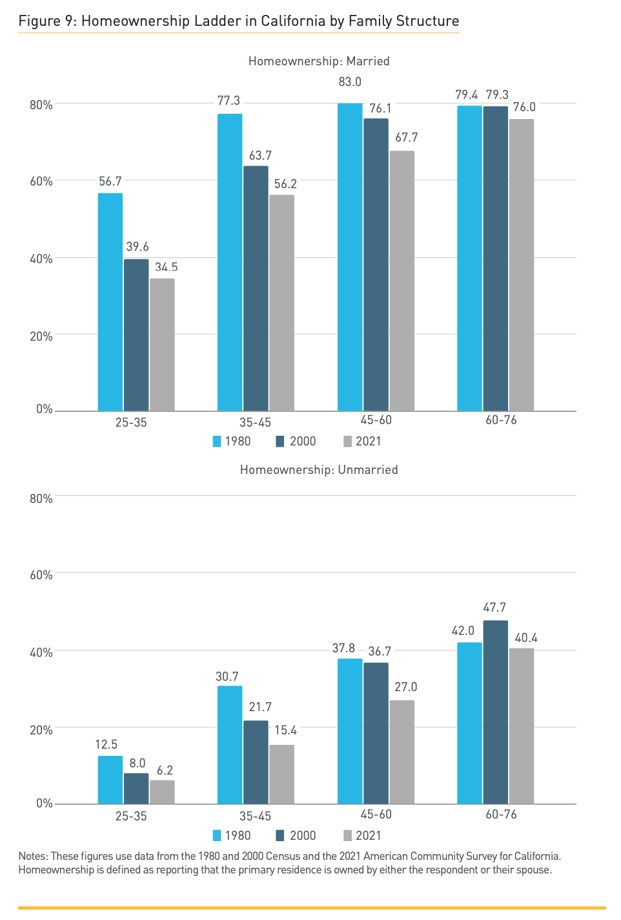
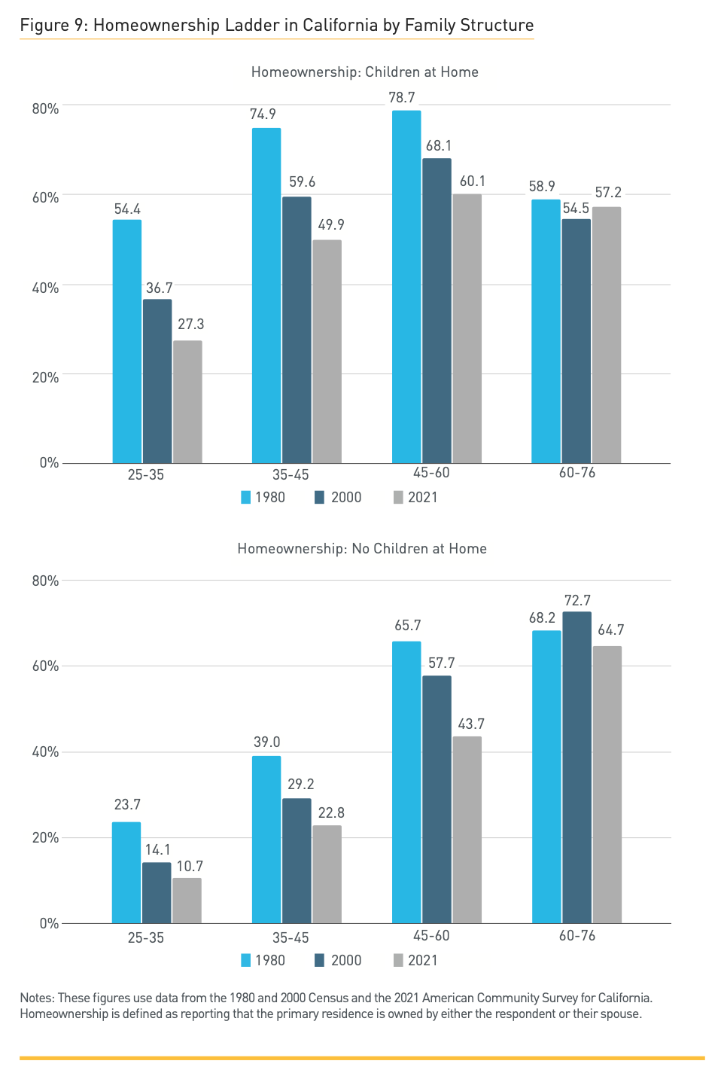
Breakouts by lifecycle milestones

Slide 8
Homeownership vs the financial ability to afford a home
The uniformity of the decline in homeownership across groups suggests an important role for housing unaffordability, as opposed to just delayed lifecycle milestones.
The ability to afford a home is of interest to policymakers in its own right: the great concern is not that Californians are not choosing to buy homes, but that they cannot afford to do so.
Therefore, we focus on the financial ability to afford a home.

Slide 9
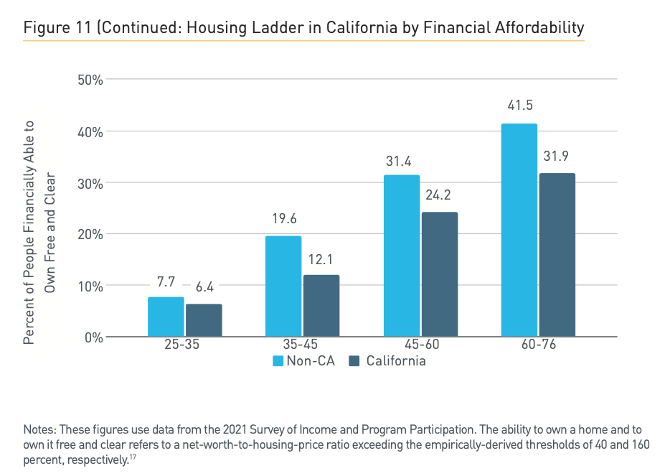
The financial ability to afford a home

Slide 10
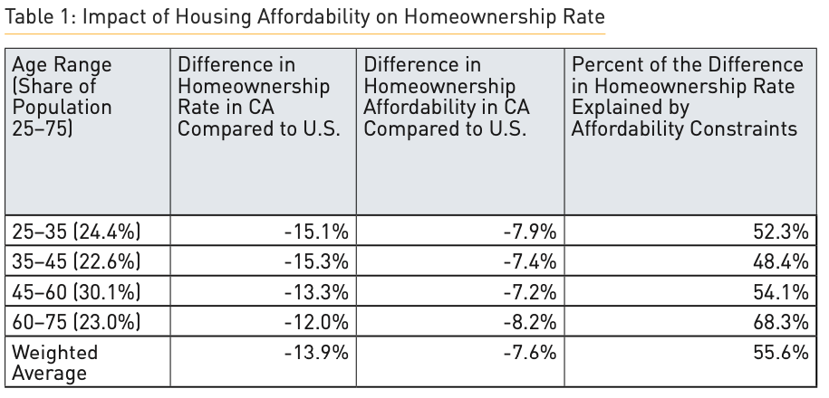
Other factors have played a part, but housing affordability has been the dominant factor

Slide 11
Simple counterfactuals: What if?
Note: These numbers refer to California’s current residents, but if prices has risen less, more people would likely live in California and the marginal residents would probably have lower average incomes than the current ones.

Slide 12
Summary
Homeownership has fallen across the board, within virtually every group of California residents
While other factors have certainly played a part in driving California’s declining homeownership rates, housing affordability has been the dominant factor.

Slide 13
* * *

