Slide 1
Hotels to Affordable Housing:
Strategies for Conversion from Across the Country
Carolina Reid, Shazia Manji, and Hayden Rosenberg
February 23, 2022

Slide 2
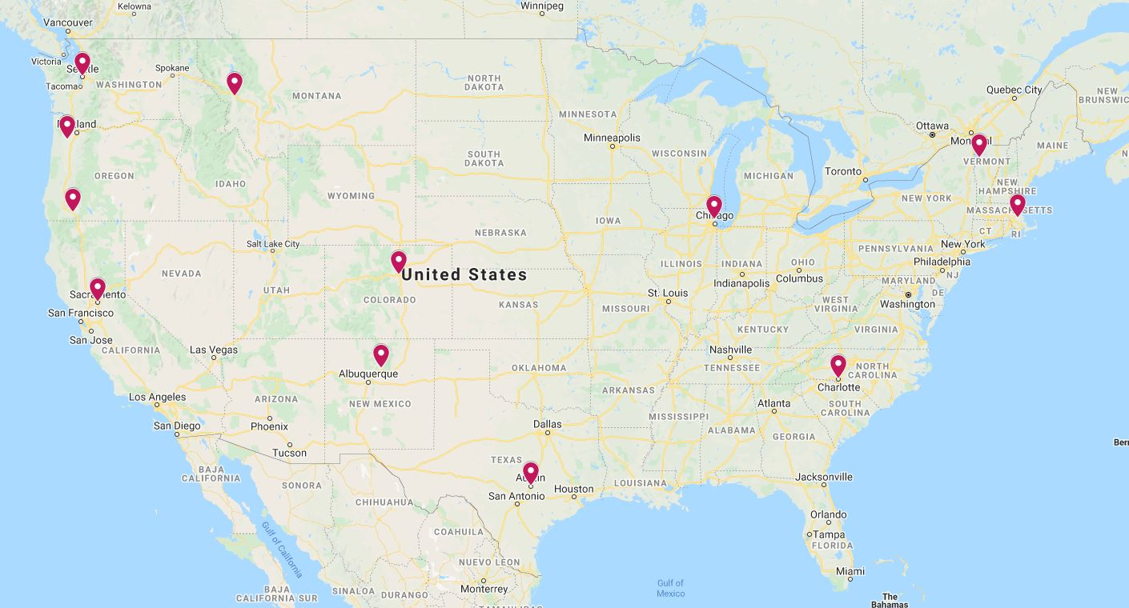
Project Overview
Case Studies:
Austin, TX
Brockton, MA
Charlotte, NC
Denver, CO
Essex Junction, VT
Evanston, IL
Seattle, WA
McMinnville, OR
Medford, OR
Missoula, MT
Sacramento, CA (2)
Santa Fe, NM
TERNER CENTER FOR HOUSING INNOVATION UC BERKELEY

Slide 3
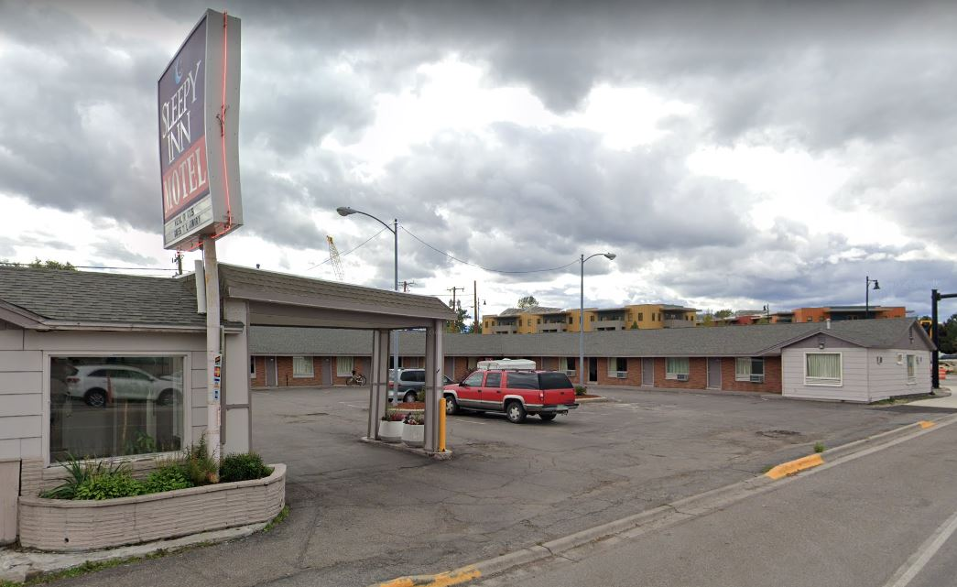
Property Use
Sleepy Inn Motel, Missoula, MT
Partners: Missoula Redevelopment Agency; Missoula Department of Community Planning, Development and Innovation
Doors: 34
Current Use: Non-congregate shelter through the pandemic, with the intention to eventually redevelop or sell.
Source: Missoula Current
TERNER CENTER FOR HOUSING INNOVATION UC BERKELEY

Slide 4
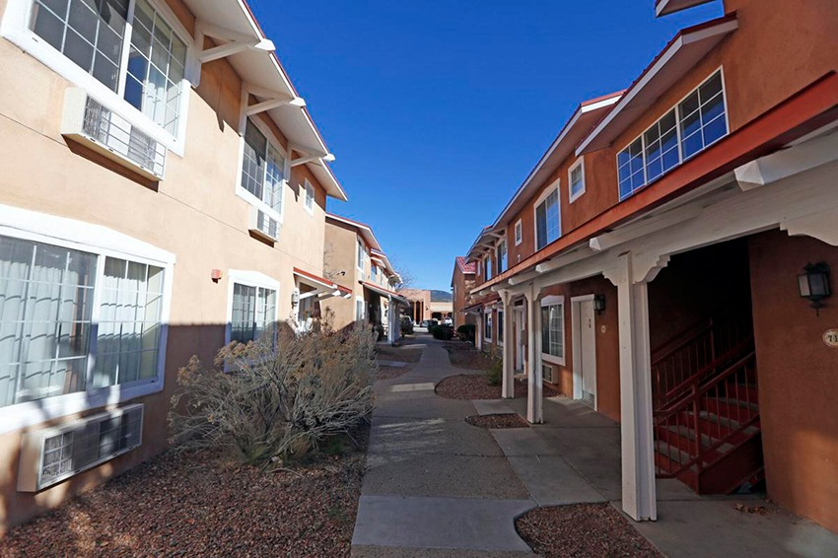
Property Selection
Santa Fe Suites, Santa Fe, NM
Partners: Santa Fe Office of Affordable Housing; Community Solutions; St. Elizabeth’s Shelter
Doors: 122
Current Use: A mix of permanent supportive housing and market-rate housing. The property was fully furnished and already set up as studio apartments with kitchenettes, TVs, and cable.
Source: Community Solutions
TERNER CENTER FOR HOUSING INNOVATION UC BERKELEY

Slide 5
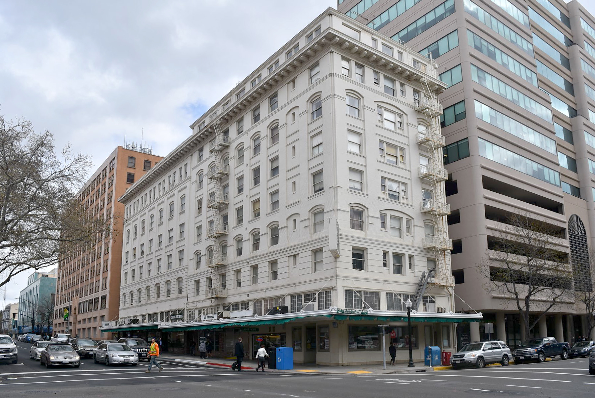
Property Selection
Capitol Park Hotel, Sacramento, CA
Partners: Mercy Housing; Sacramento Housing and Redevelopment Agency
Doors: 134
Current Use: Under renovation.
The property was used as temporary shelter from Sep 2019 – Oct 2020, before beginning rehabilitation in Jan 2021. The property needs seismic upgrading, room layout reconfiguration, and complete interior remodeling.
Source: Mercy Housing
TERNER CENTER FOR HOUSING INNOVATION UC BERKELEY

Slide 6
Neighborhood Poverty Rate
TERNER CENTER FOR HOUSING INNOVATION UC BERKELEY

Slide 7
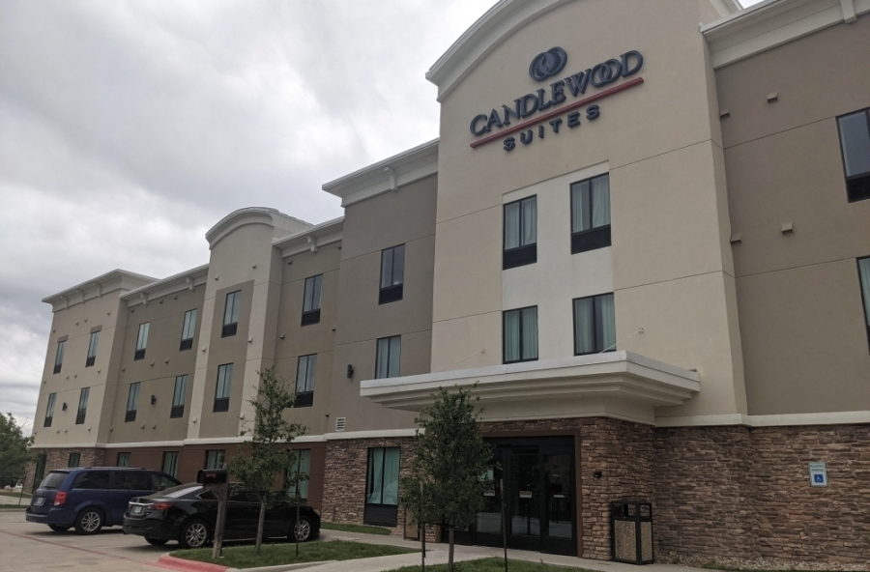
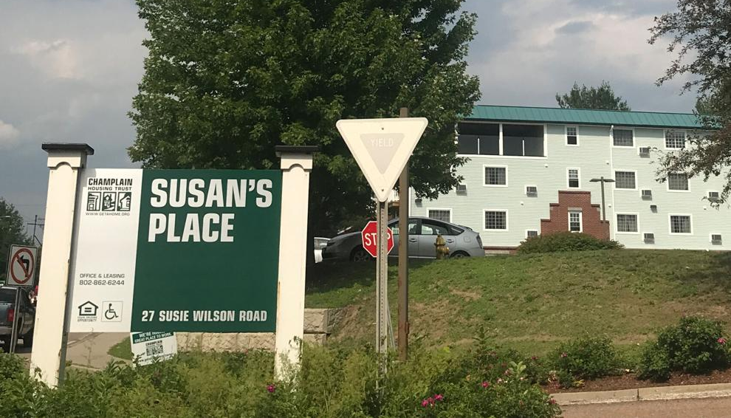
Land Use Regulations
Local land use regulations shape what can be built on site, and can limit maximizing the adaptive re-use of an existing building
Susan’s Place, Essex Junction, VT
Conversion projects can face significant community opposition
Candlewood Suites, Austin, TX
Source: The Essex Reporter
Source: Community Impact Newspaper
TERNER CENTER FOR HOUSING INNOVATION UC BERKELEY

Slide 8
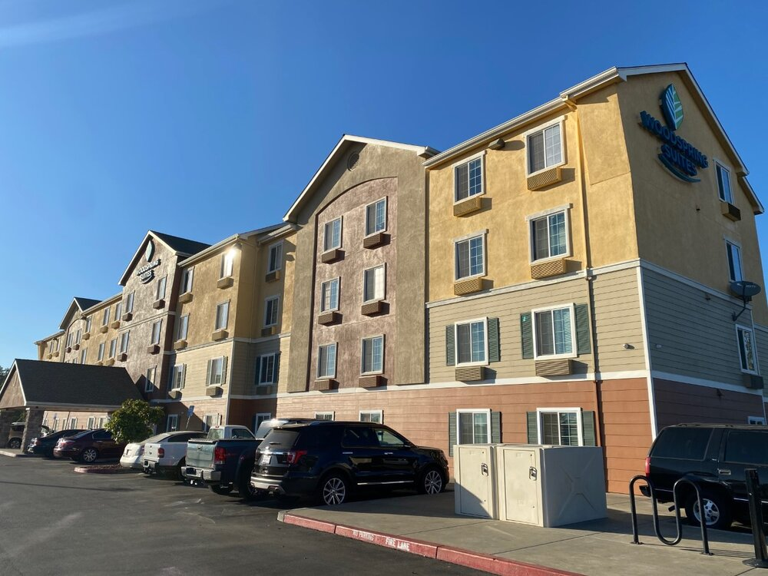
Streamlining Land Use Regulations
State-level streamlining legislation can help to facilitate conversions and shorten development timelines
Examples of state legislation:
California:
AB 83
Oregon:
HB 3261
HB 2006/4212
La Mancha Project, Sacramento
Source: Mayors Office of Civic Engagement, City of Sacramento
TERNER CENTER FOR HOUSING INNOVATION UC BERKELEY

Slide 9
Financing
Federal funding allowed expansion of conversion strategies
Local market conditions influence costs
Total acquisition costs ranged from $1.1 million in Missoula, MT to $16.5 million in Seattle, WA
TERNER CENTER FOR HOUSING INNOVATION UC BERKELEY

Slide 10
Conversion Costs
TERNER CENTER FOR HOUSING INNOVATION UC BERKELEY

Slide 11
Operations and Services Funding
Financing for long-term operations and services remains a major challenge
Project-based vouchers key to financing operations, but demand outstrips supply and coordination with local PHA can be challenging
Medicaid waivers are promising, but high administrative barriers to implement
TERNER CENTER FOR HOUSING INNOVATION UC BERKELEY

Slide 12
Partnerships
Conversion projects operate within a broader housing and homelessness response ecosystem
Strong partnerships are an important factor in project success
Hotel/Motel
Conversion
Developer
Resident Services Provider
Coordinated Entry System/
Eligibility
City/County
Health System
Property Manager
TERNER CENTER FOR HOUSING INNOVATION UC BERKELEY

Slide 13
Partnerships
Conversion projects operate within a broader housing and homelessness response ecosystem
Strong partnerships are an important factor in project success
Coordinated entry systems and connecting eligible residents to units can be challenging
Hotel/Motel
Conversion
Developer
Resident Services Provider
Coordinated Entry System/
Eligibility
City/County
Health System
Property Manager
TERNER CENTER FOR HOUSING INNOVATION UC BERKELEY

Slide 14
Partnerships
Conversion projects operate within a broader housing and homelessness response ecosystem
Strong partnerships are an important factor in project success
Coordinated entry systems and connecting eligible residents to units can be challenging
Culturally responsive service provision is key in correcting racial and other disparities in unhoused and unsheltered populations
Hotel/Motel
Conversion
Developer
Resident Services Provider
Coordinated Entry System/
Eligibility
City/County
Health System
Property Manager
TERNER CENTER FOR HOUSING INNOVATION UC BERKELEY

Slide 15
Lessons Learned
Flexible, grant capital allows jurisdictions to target projects to local needs, shortening development timelines substantially
Need to solve for lack of sufficient long-term operation subsidies, e.g., stronger coordination and alignment with PHAs, expansion of project-based voucher authority, Medicaid waivers
Reducing regulatory burden–both in program administration and in land use laws–are critical to shortening development timelines
Improving coordination, technical capacity
Partnerships and coordination across entities are critical for successful conversions
TERNER CENTER FOR HOUSING INNOVATION UC BERKELEY

